Slide 1
Army OneSource
Building Awareness Campaign
Legal Assistance
Focus Area

Slide 2
Legal Focus Area Goals
Goals of Army OneSource Building Awareness Campaign
Legal Assistance Focus Area:
Raise awareness of the challenges of Military life before, during, and after deployment.
Engage legal professionals in providing specialized services to Service Members and their Families by building collaborative relationships with existing programs.
Fill gaps in available legal services and support for Service Members, especially those who live far from Military installations.

Slide 3
AOS Building Awareness Campaign
Legal Assistance Focus Area
Facts About Our Service Members and Families

Slide 4
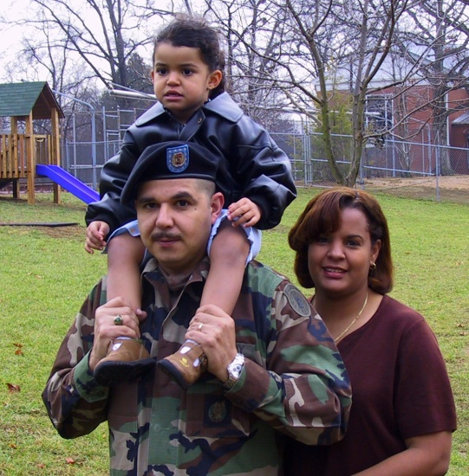
Facts About Our Service Members and Families
Our Service Members and Families:
Over 1.5 million Service Members have served in Iraq and Afghanistan to date.
Nearly half of them have experienced multiple deployments.
Reservists and National Guard make up about half of our active duty Armed Forces.

Slide 5
Facts About Our Service Members and Families
56% of our Service Members are under 26 years old.
49.8% of Active Duty Service Members and 55% of Reservists are married.
77% of Military Families require a second income.
About a third of our Veterans live in rural areas where there are no VA facilities nearby.

Slide 6
Facts About Our Service Members and Families
Factors that add stress to Service Members and Families:
The Global War on Terror is unlike any past Military operation: no front line; use of improvised explosive devices.
Deployed Military personnel must be on constant vigilance 24/7.
Young Service Members and their Families are not prepared to deal with the emotional, spiritual, and financial challenges of Military life.
Extended separations, shifting responsibilities at home, and recurring and longer deployments take their toll.
A Defense Department study showed that legal issues/concerns are second only to career and mission issues as top stressors among Service Members.

Slide 7
AOS Building Awareness Campaign
Legal Assistance Focus Area
Common Legal Challenges Encountered by Service Members and Families

Slide 8
Common Legal Challenges
Common Legal Challenges Encountered by Service Members and Their Families:
From JAG and legal system interviews
Separation and divorce
Family support (soldier deployed)
Child custody
Domestic violence
Financial support
DUI
Paternity orders
Contracts and leases
Wills
Power of Attorney
Immigration

Slide 9
AOS Building Awareness Campaign
Legal Assistance Focus Area
Impact of Legal Issues on Military Operations

Slide 10
Impact on Military Operations
Legal problems also affect Military operations:
Require significant time of Military leadership
Loss of security clearances, making it impossible to fulfill Military duties (including deployment)
Loss of driving privileges on post (DUI)
Lowering of morale of the unit
Inability to focus on duties

Slide 11
AOS Building Awareness Campaign
Legal Assistance Focus Area
Driving Under the Influence (DUI) and Other Criminal Behaviors

Slide 12
DUIs and Other Criminal Behaviors
DUI and Substance Abuse
182 Soldiers and/or Family Members at Ft. Carson were cited while driving under the influence on post since November of 2006.
Fort Campbell Federal Court prosecutors reported a monthly average of between eight and fifteen DUIs.
81% of incarcerated Veterans had a substance abuse problem prior to incarceration.
35% of incarcerated Veterans were identified as suffering from alcohol dependency.
Sources: 2000 Bureau of Justice Statistics Report; New York Times. AOS staff is researching and compiling more recent data for use in this presentation.

Slide 13
DUIs and Other Criminal Behaviors
“The Military’s regulations often subject its members to enhanced Non-Judicial Punishment (NJP), which goes above and beyond the punishments allowed by civilian law.”
Camp Pendleton Marines Face
Severe Consequences for DUI
March 26, 2010, T. Gabeh

Slide 14
DUIs and Other Criminal Behaviors
Veterans in the Criminal Justice System
[Data from 2007]
Probation 399,300
Parole-Supervised Release 75,000
Local Jail 72,600
State Prison 136,800
Federal Prison 19,300
Total Correctional – 703,000
Adults Arrested – 1,159,500
Source: Bureau of Justice Statistics

Slide 15
AOS Building Awareness Campaign
Legal Assistance Focus Area
Military Divorce Rates

Slide 16
Military Divorce Rates
“Divorce rates run even higher in…occupations…that expose people to traumatic events and danger, as well as heavy responsibilities and public scrutiny.”
Army Officials
Reducing the Military Divorce Rate, Donna Mills, June 2005

Slide 17
Military Divorce Rates
Military Divorce Rates Climbing
The number of divorces among Active Duty Forces in 2004 was 10,477 and was reported to have climbed steadily over the previous five years.
In 2009, there were an estimated 27,312 divorces among the married forces of the Active Military.
In 2003 and 2004, the divorce rate was higher among Army officers than their enlisted counterparts, reversing the previous trend.
Divorces among married officers jumped from almost 1,900 in 2003 to more than 3,300 in 2004.
Source: Washington Post. AOS staff is researching and compiling more recent data for use in this presentation.

Slide 18
Military Divorce Rates
Legal issues related to high Military divorce rate:
Complicated child custody situations
Legal separation
Status of benefits for spouses and dependents
Navigating through divorce proceedings
Continued support of dependents and spouses
Child care when the deployed Service Member has custody
Source: Washington Post

Slide 19
Military Divorce Rates
“The toll goes beyond the human side, and affects
Military operations as well. Service Members in happy marriages tend to be more focused on their jobs and less likely to become disciplinary problems. They’re also
more likely to remain in the Military.”
Army Chaplain (Col.) Glen Bloomstrom
Director of Ministry Initiatives, Army’s Office of the Chief of Chaplains
Source: “Reducing the Military Divorce Rate,” June 2005, Donna Miles

Slide 20
AOS Building Awareness Campaign
Legal Assistance Focus Area
Domestic Violence and Child Abuse in the Military

Slide 21
Domestic Violence and
Child Abuse
Domestic Violence and Child Abuse in the Military on the Rise
Reports of domestic abuse at Ft. Hood Military installation have grown by 75% since 2001.
Nationally, an independent investigation found that over 25,000 spouses and domestic partners have been attacked over the past decade.
Another independent investigation indicated that reports of child abuse reached nearly 17,000 in 2000, and 8,000 of those reports were substantiated by the U.S. Military’s Family Advocacy Program.
Sources: Domestic Abuse and the Military, CBS Evening News, January 2009; Domestic Abuse in Military Families, When Abuse Happens on the Homefront, Brain Injury Association of America

Slide 22
Domestic Violence and
Child Abuse
Reluctance to Report Abuse
Victims of domestic violence or child abuse in the Military are often reluctant to report incidents for fear it will impact a spouse’s career.
Constant relocation tends to isolate victims by severing their ties with family and loved ones, making it even less likely they will report any abuse.
Families lack knowledge about how separation and divorce will affect their benefits, child support, etc., so they live with the abuse out of fear.

Slide 23
AOS Building Awareness Campaign
Legal Assistance Focus Area
Legal Assistance
Programs

Slide 24
Legal Assistance Programs
ABA Military Pro Bono Project
The ABA Military Pro Bono Project, launched in 2008, is a one-of-a-kind, web-based venture that improves access to pro bono civil legal assistance for Active Duty Military Personnel, including Active Duty Members of the National Guard and Reserves, while expanding opportunities for firms and attorneys to provide pro bono services. Exclusively devoted to supporting Active Duty Personnel.

Slide 25
Legal Assistance Programs
Legal Assistance for Military Personnel (LAMP)
Foster growth of the Military legal assistance programs
Promote delivery of legal services to Military Personnel, their Family Members, and persons accompanying the Armed Forces outside the United States
Enhance the scope, quality, and delivery of free or affordable legal services to eligible legal assistance clients

Slide 26
Legal Assistance Programs
Young Lawyers Division
The American Bar Association Young Lawyers Division (ABA YLD) is the home for young lawyers. With over 150,000 members and 300 affiliated groups, the ABA YLD is the largest young lawyer organization in the world. The Division is committed to assuring that it is best able to represent the newest members of the profession, ensuring that it reflects the society it serves, and providing young lawyers and young lawyer organizations with the tools and opportunities for professional and personal success.

Slide 27
AOS Building Awareness Campaign
Legal Assistance Focus Area
Benefits of Participating in AOS Building Awareness Campaign
Legal Assistance
Focus Area

Slide 28
Benefits of Participating
How does participating in this effort benefit you or your organization?
Increased awareness of the unique legal challenges faced by Service Members and their Families
Opportunity for involvement in meaningful outreach
Opportunity to fill a need that has national attention

Slide 29
AOS Building Awareness Campaign
Legal Assistance Focus Area
Involvement in AOS Building Awareness Campaign
Legal Assistance
Focus Area

Slide 30
Involvement
What is involved in participating in this effort?
Explore opportunities for participation
Seek and act on opportunities to reach out to Service Members and
Families who are in need of legal assistance
Make a commitment to participate in the AOS Building
Awareness Campaign: Legal Focus Area
Work within a framework of one or more existing programs that best fit your needs and interests

Slide 31
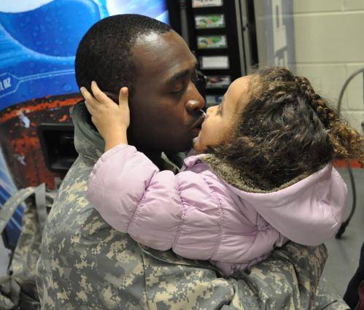
AOS Building Awareness Campaign
Legal Assistance Focus Area
Helping our Service Members and their Families . . .
LIVE THE LIVES THEY DESERVE!

